Slide 1
Eat Easy
Arpit Vyas, Benjamin Tan, Rebecca Lysaght, Yiqi Lin

Slide 2
The Unique Sales Proposition
Like Tinder for restaurants. Users sign up, tell us when they want to eat and what kind of food they’d like, then our algorithm recommends the best restaurant in the area according to their preferences.

Slide 3
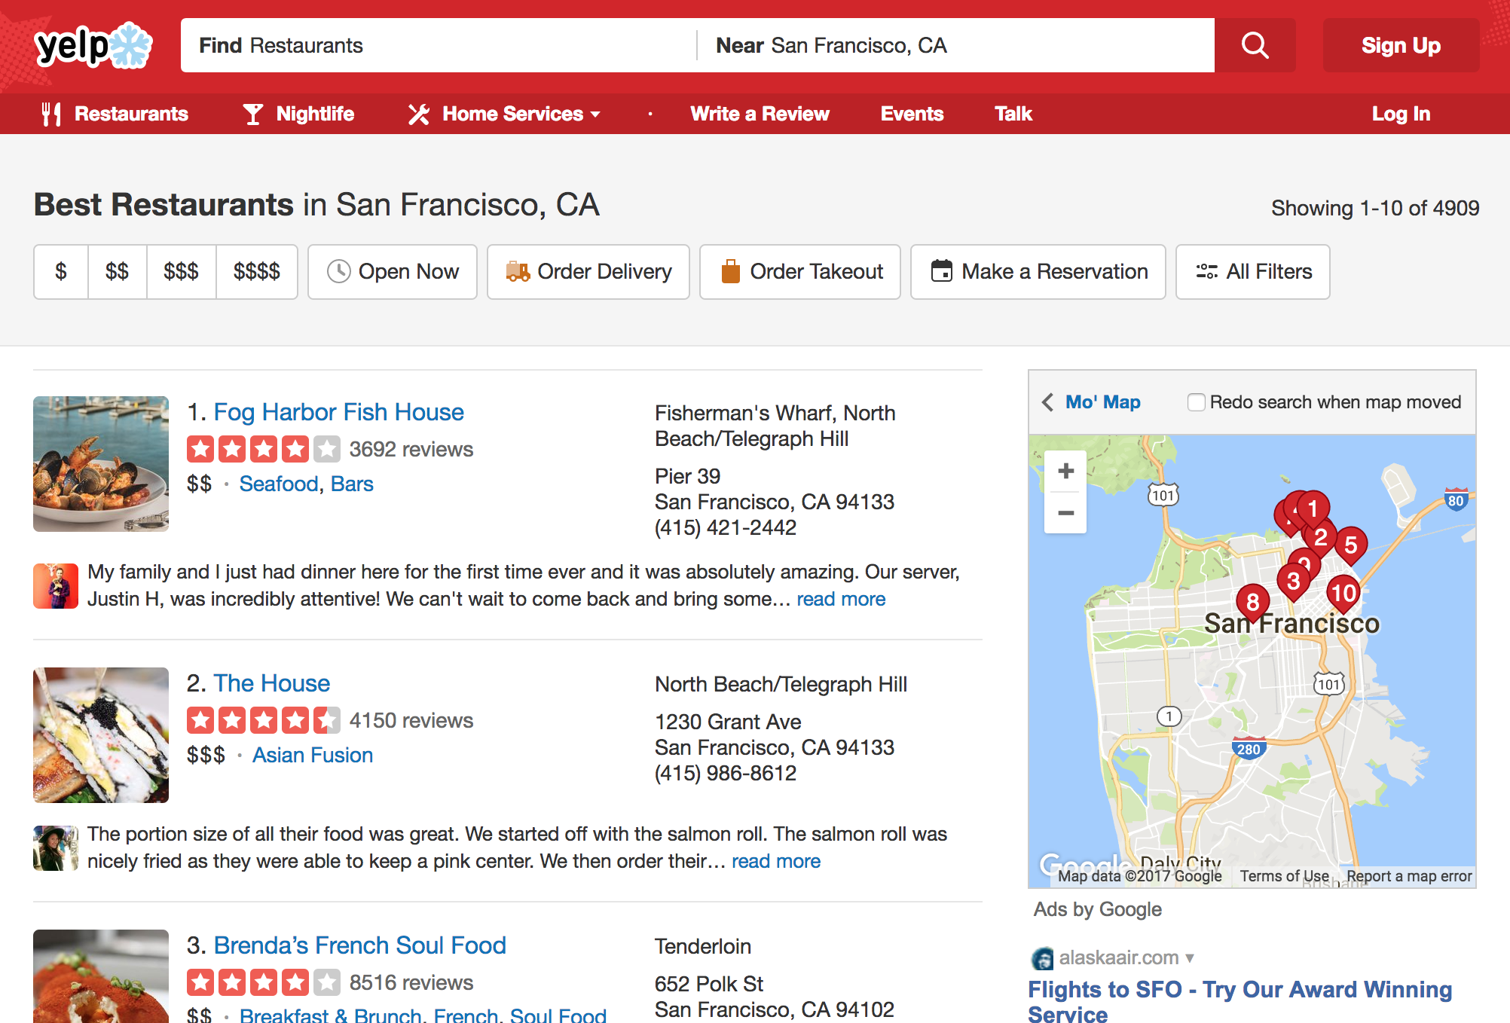
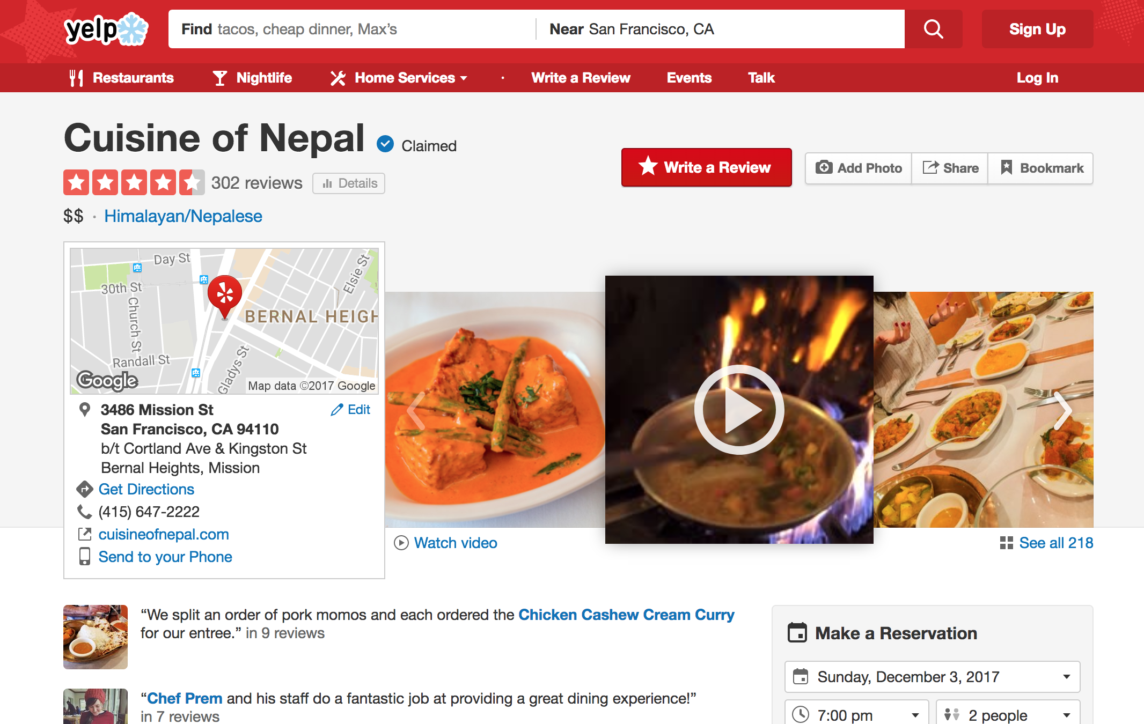
Easy, Fast, Simple
Removes the burden of choice from the user.
Other apps today have effective recommendation systems, but they return a list of results that is then still difficult to choose from
Our design is cleaner: it removes unnecessary information so as not to overwhelm the user. Plus swiping left or right makes it feel like a game!

Slide 4



Market Analysis
Current Apps:
OpenTable: limits users to restaurants that take reservations
Zomato: Returns a list of restaurants for the user to choose from
Yelp: Not specific to restaurant recommendation
Market Size:
Revenue: $713 million for Yelp, $49 million for Zomato in 2016
Millions of users
In 2020, mobile apps are projected to generate $189 billion

Slide 5
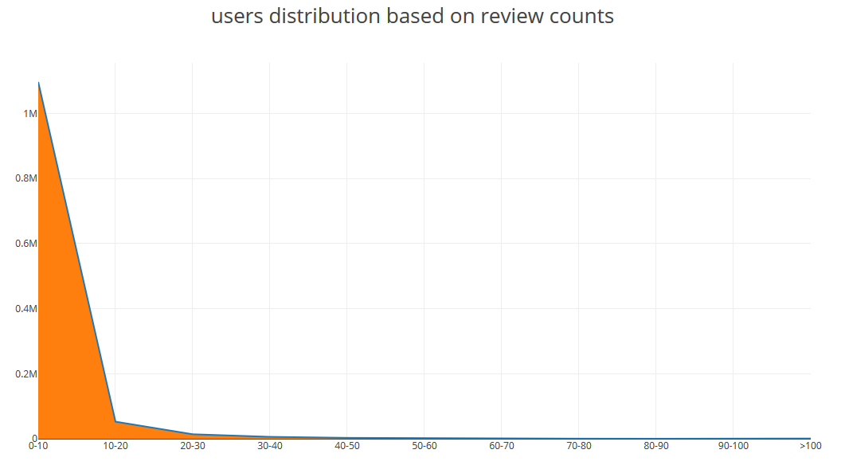

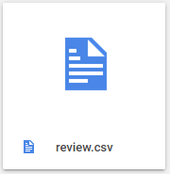
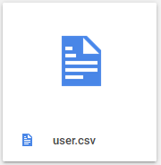
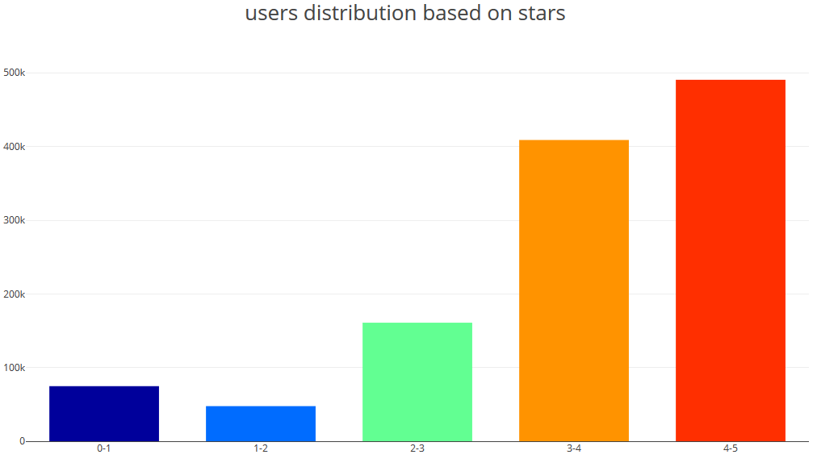
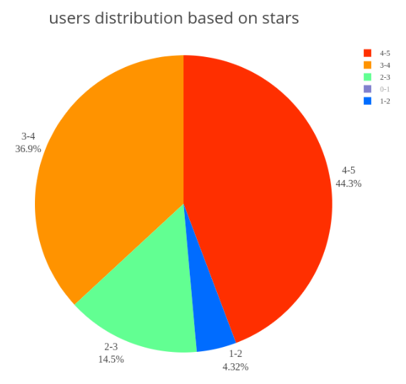
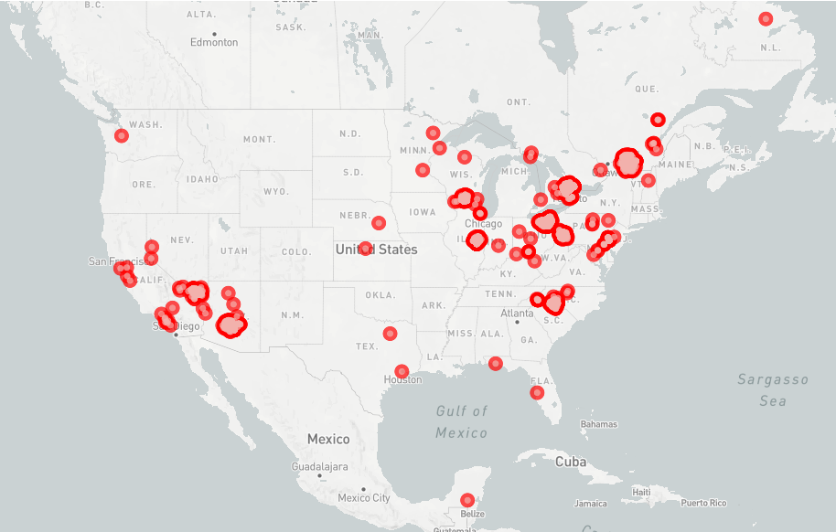
The Yelp Dataset

Slide 6
Matrix Factorization
A form of Collaborative Filtering Method
Scales and deals with sparse data better
Captures latent relationship between user and item
U is a vector of interests of i-th user and V is a vector of parameters for j-th restaurant.
Business id
d
R
U
Business id
User id
User id
≈
×
d
V

Slide 7
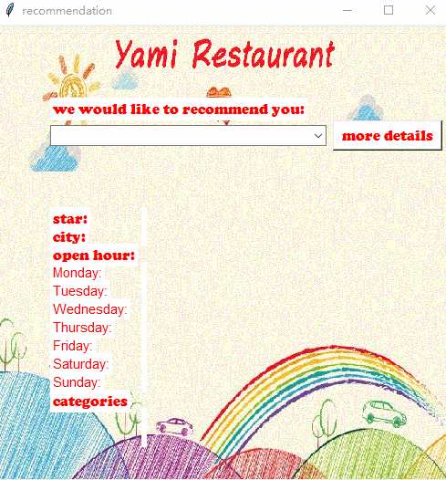
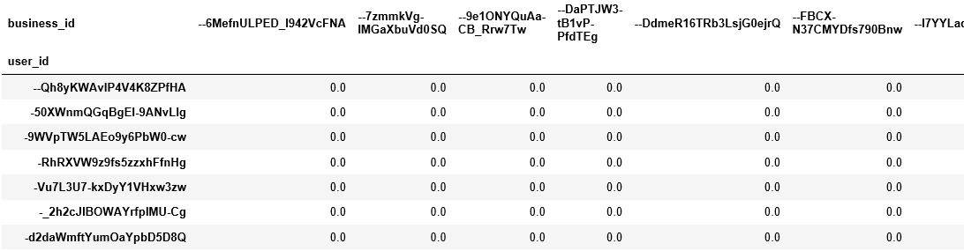
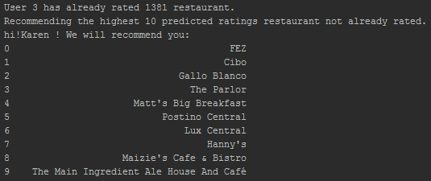
Matrix Factorization

Slide 8
New thoughts besides this popular method
Can this system be more user friendly ?
Add filter
Can we add more features to get a more accurate result ?
NLP, regression model
How do we deal with new users since there is no information of them ?
Cold start
How do we get the users’ ideas and make the system more customized?
Feedback from users

Slide 9
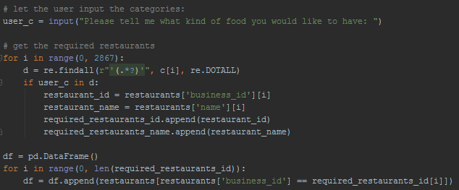
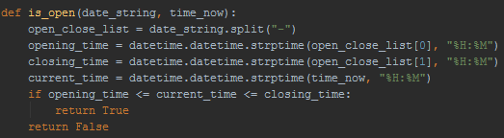
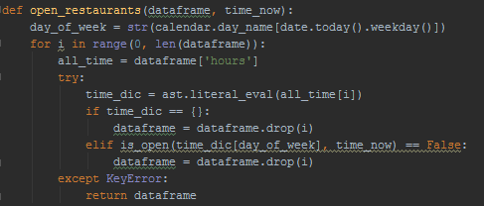
Filter
User inputs the kind of food they would like and the time they plan to eat
Those filters are then applied to make the recommendation user-specific
Filters:
Food categories
Mexican, bagels, etc.
Meal time
Only returns open restaurants

Slide 10
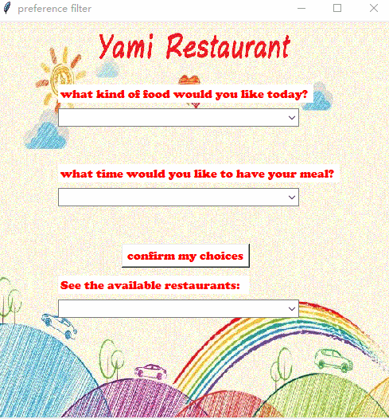
Filter
Collect all restaurant categories, ask the user which category of food they would like, iterate over all restaurants; if the restaurant belongs to the user category, add it to the list.
open_restaurants takes in a restaurant dataframe and a meal time, iterates over all restaurants, extracts each restaurant’s weekly hours as stored in the dataframe and removes all restaurants that are not open during the given meal time.

Slide 11
Recommendation Model
For user A:
Restaurant 1 | Score 1
Restaurant 2 | Score 2
Restaurant 3 | Score 3
Restaurant 4 | Score 4
Restaurant 5 | Score 5
Restaurant 6 | Score 6
Restaurant 7 | Score7
Y = b0 + b1*X1 + b2*X2 + b3*X3+ b4*X4
X1 : modified global star of the restaurant on user A’s perspective
X2 : Similarity between user A and the restaurant
X3 : Reciprocal of distance
X4 : Average star rating

Slide 12
Recommendation Model
Logistic Regression model
Customized part
X1 : modified global star
Y = b0 + b1*X1 + b2*X2 + b3*X3 + b4*X4
X2 : Similarity
X3 : Reciprocal of distance
X4 : Average star rating
Scores given by User A for restaurants he/she has already been to are used as labels
Not used while training the model, but appears in the recommendation algorithm

Slide 13

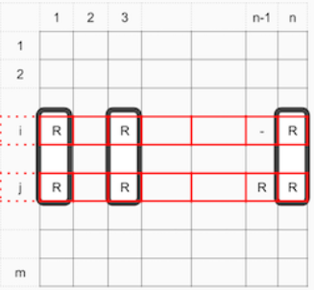
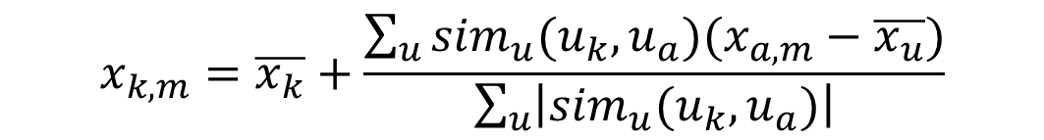
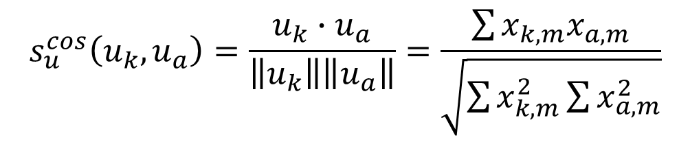
Logistic Regression
X1 : modified global star of the restaurants from user A’s perspective
(General)
For user A, the global star should be modified global star, the score each user gives to the restaurant should have different weights based on the similarity between them and user A
m: restaurant, u: whole user group

Slide 14
Logistic Regression
Restaurants
X2 : Similarity between user A and the restaurants
Features
Restaurant 1
Restaurant 2
Restaurant 3
Restaurant 4
Restaurant 5
……………
Restaurant 7
Reviews
Restaurant 1
Restaurant 2
Restaurant 3
Restaurant 4
Restaurant 5
…………..
Restaurant 7
User A
NLP
NLP
Reviews
Features
Similarity

Slide 15
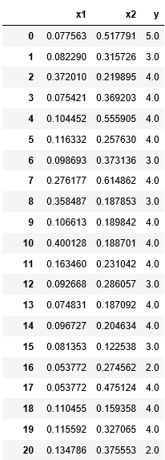
Logistic Regression
W = b0 + b1*X1 + b2*X2
UserA gets to a new restaurant
X1
X2
Logistic Regression
Model
Predicted
W

Slide 16
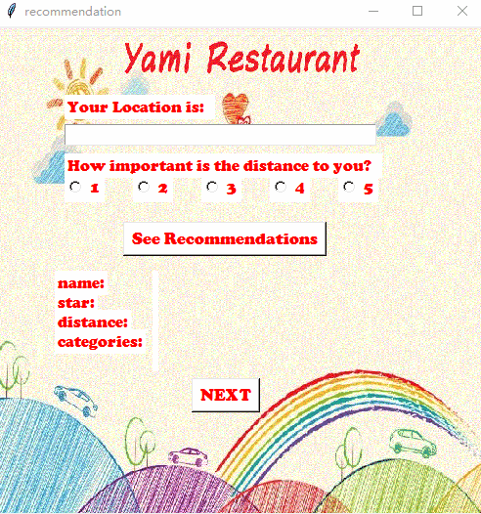
Customized part
Let the user make the decision !
Y = a1*W +a2*X3+a3*X4
(X3 = 1/distance, X4 =average star)
The weight for the distance depends on the situation:
When you are really in a hurry
a2
Very High
When you are in a holiday and want to have a good meal regardless of the distance
a2
Very Low

Slide 17
Cold Start
Database of Users
Similarity Index
The purpose of the cold start is to formally introduce a new user to our existing database.
The cold start looks at 2 different categories (i.e. food and cuisine) and implements a ranking system for these two user inputs.
Food
Recommendation (Max Similarity)
Cuisine
Notes:
For the way forward, depending on the food and cuisine, the existing database of users will be clustered to output the same recommendation for the selected combination of food and cuisine

Slide 18
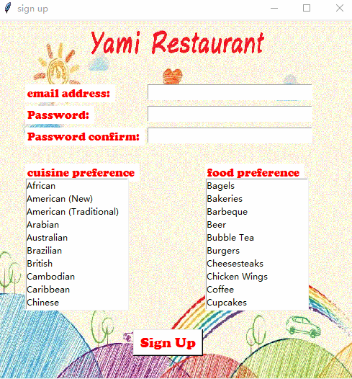
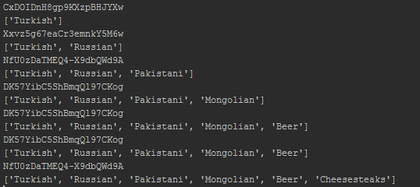
Cold Start
The list of preferences change, the similar user the system gives may also change

Slide 19
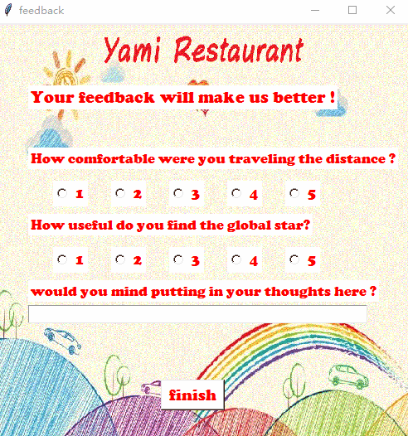
The Feedback Loop
It is pivotal to incorporate user experience into our model to achieve a better accuracy of prediction
We aim to input user feedback in terms of weights for our features and re-run the algorithm
Feedback to be taken on -
Distance,
Global ratings
User Review

Slide 20
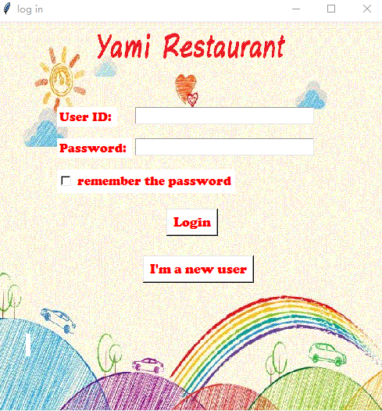
Application Interface Flow
Logging into the user account

Slide 21
Step 1 - Sign-in
Logging into the user account

Slide 22
Step 1 - b : Sign-up/ Cold Start
At the time of sign up we prompt the user to key in their cuisine preference and food preference.
Forms a basis for a filter at the start of the algorithm.

Slide 23
Step 2 : Filters
Meal choice filter
Meal time filter

Slide 24
Step 3 : The Recommendation
The highest scored restaurant is going to feature as the top choice
If disapproved by the user, the next best shows up, and so on.

Slide 25
Step 4 : The Feedback Loop
These feedback responses will help us improve our weights in our regression model.
Additionally, review by the user will help us with a denser matrix every time a user uses the app

Slide 26
Extensions to our project
Including the average price of the businesses (not available with the original data)
Use of RNN to store weights to different features from user feedback and using it for making prediction
Use clustering to find the most relevant neighbours and then conduct collaborative filtering for a better accuracy

Slide 27
References
Ouyang, W., Xue, M., & Yu, M. (2015). Restaurants Review Star Prediction for Yelp Dataset.
Fan, M., & Khademi, M. (2014). Predicting a Business Star in Yelp from Its Reviews Text Alone. CoRR, abs/1401.0864.
https://data-x.blog/resources/
https://beckernick.github.io/matrix-factorization-recommender/

Slide 28
Thank You!
Questions?

